Slide 1
Capstone Project Airbnb Bookings Analysis By Amit kashyap
Anirn Patra

Slide 2
Objective
Define a problem statement
Exploratory Data Analysis
Data visualization
Obtaining crtical insights

Slide 3
Data summary
Id- It provides a unique id to each listing in the dataset.
Name-It describes the property in a concise manner.
Host_id-It is used to ascertain the ownership of a certain individual
Host_name-It is the name of the property owner
Neighbourhood_group-It basically categorizes neighbourhood into five groups Bronx,Brooklyn,
Manhattan,Staten Islands and Queens
Neighbourhood-It designates the location of a property.
Lattitude-It Specifies the Lattitude of the property.
Longitude-It denotes the Longitude of the property.
Room_type-It classifies the type of property into Private_Room,Shared_Room and Entire_Apartment.

Slide 4
Data summary
Price- It provides the price of each listed property.
Minimum_Nights-It gives the minimum night one needs to pay for in the property.
Number_of_reviews-It is used to ascertain the number of reviews received by a property.
Reviews_per_month-It denotes the number of reviews per month.
Calcuated_host_listings_count-It corresponds to the number of properties hosted by the unique host_id
Availability_365-The number of days the property is available in a year.

Slide 5
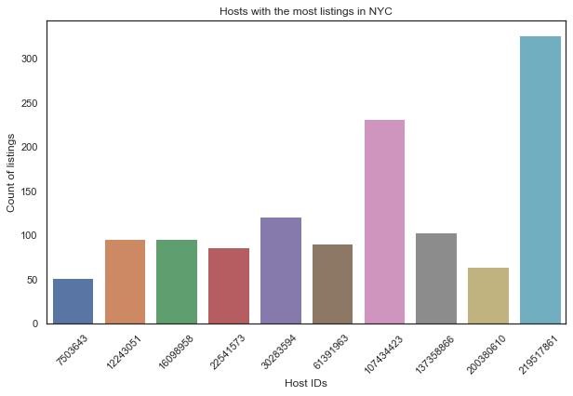
Exploratory Data Analysis

Slide 6
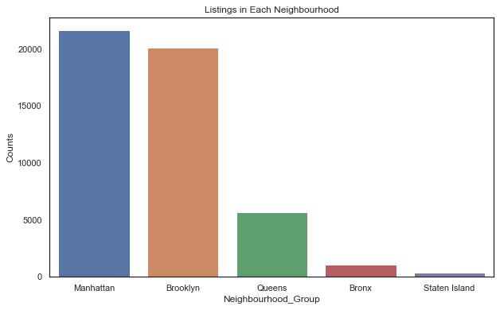
Exploratory Data Analysis

Slide 7
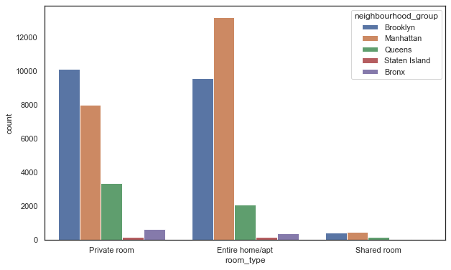
Exploratory Data Analysis

Slide 8
Exploratory Data Analysis

Slide 9
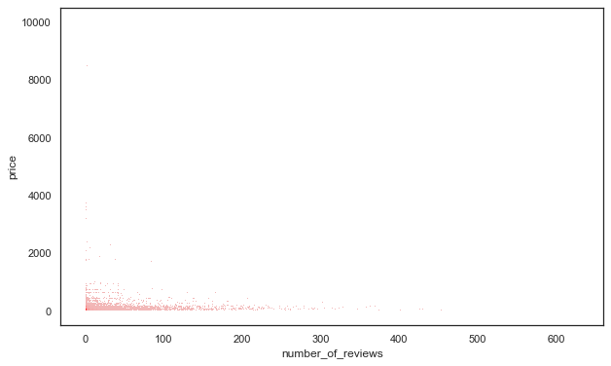
Exploratory Data Analysis

Slide 10
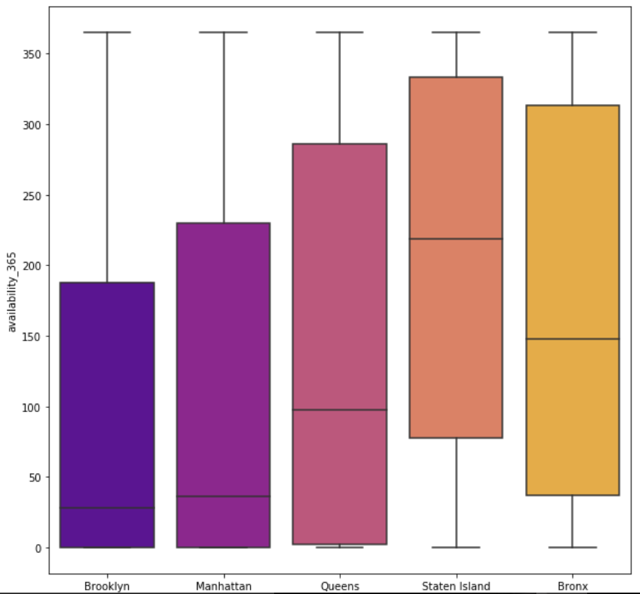
Box plot graph

Slide 11
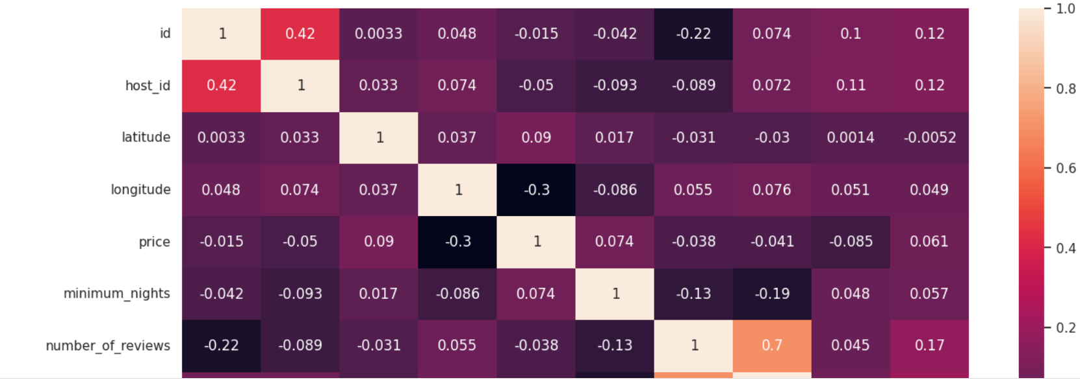
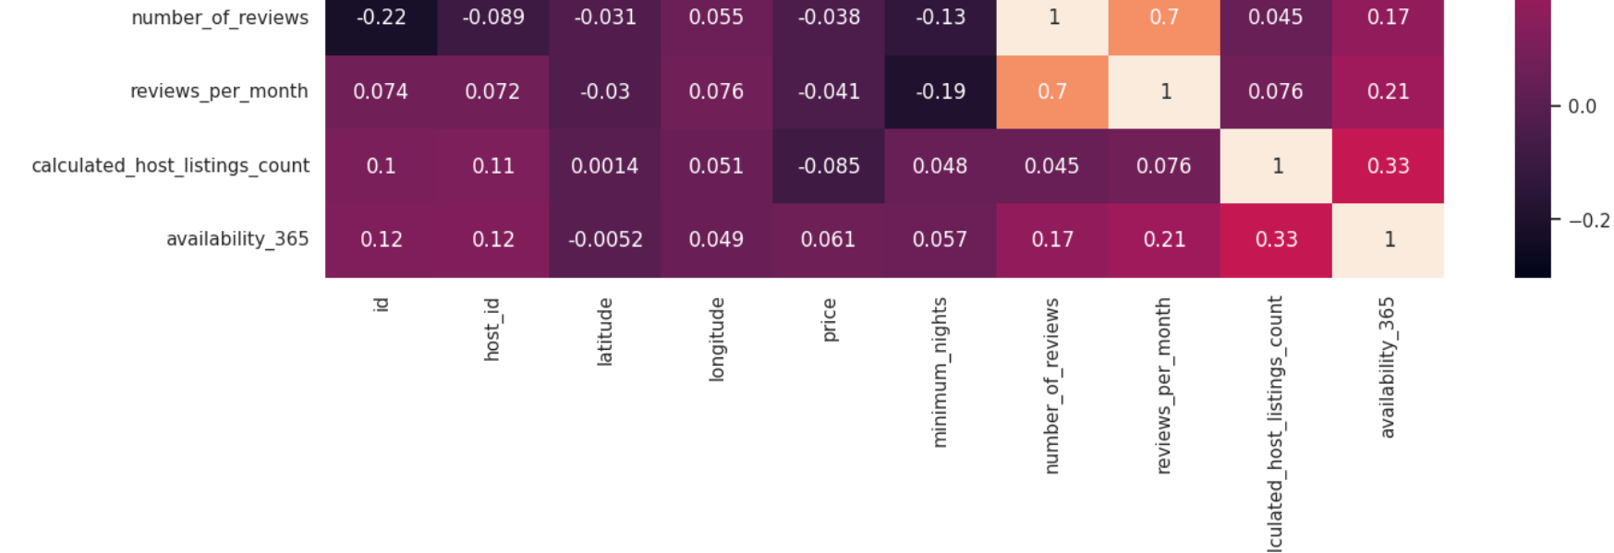
Correlation heatmap

Slide 12
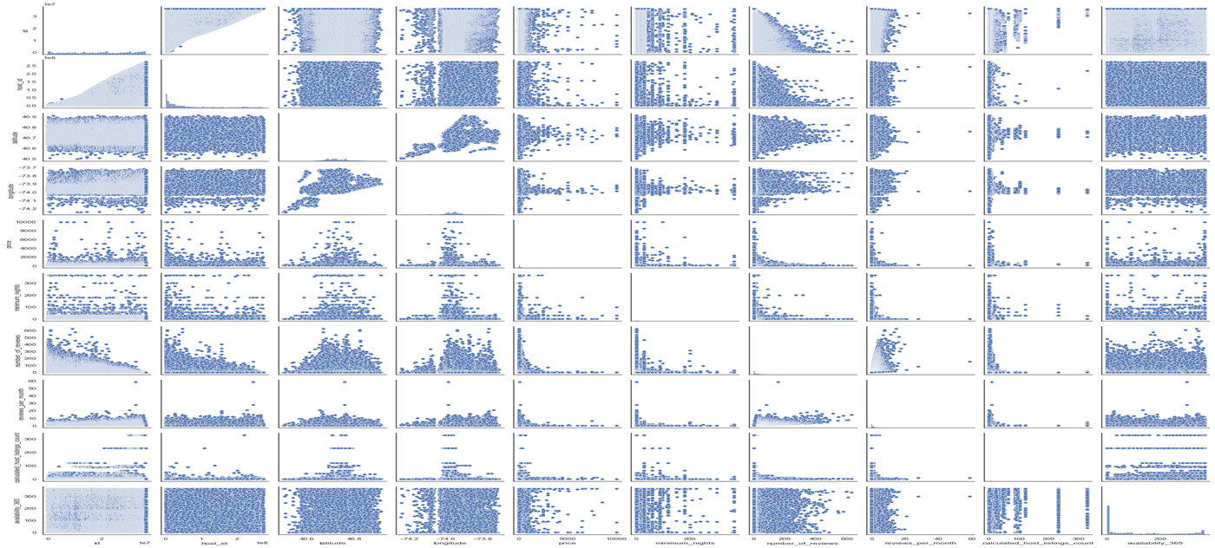
Pairplot for Analysis

Slide 13
Conclusion
Brooklyn offers nearly the same number of private rooms and entire home whereas Manhattan offers highest number of entire homes followed by private rooms.
Manhattan is the most expensive neighbourhood_group followed by Brooklyn Staten Island Queens and Bronx.
Most Listings offer Entire home followed by Private Room and Shared Room
The Majority of the listings are located in Manhattan and Brooklyn whereas Bronx and Staten Island have a miniscule share.

